Slide 1
Data Dependences and Parallelization

Slide 2
Agenda
Introduction
Single Loop
Nested Loops
Data Dependence Analysis

Slide 3
Motivation
DOALL loops: loops whose iterations can execute in parallel
New abstraction needed
  Abstraction used in data flow analysis is inadequate
    Information of all instances of a statement is combined
for i = 11, 20
a[i] = a[i] + 3

Slide 4
Examples
for i = 11, 20
a[i] = a[i] + 3
Parallel
for i = 11, 20
a[i] = a[i-1] + 3
Parallel?

Slide 5
Examples
for i = 11, 20
a[i] = a[i] + 3
Parallel
for i = 11, 20
a[i] = a[i-1] + 3
Not parallel
for i = 11, 20
a[i] = a[i-10] + 3
Parallel?

Slide 6
Agenda
Introduction
Single Loop
Nested Loops
Data Dependence Analysis

Slide 7
Data Dependence of Scalar Variables
True dependence
Anti-dependence
Output dependence
Input dependence
a =
= a
a =
a =
= a
a =
= a
= a

Slide 8
Array Accesses in a Loop
for i= 2, 5
a[i] = a[i] + 3
a[2]
a[3]
a[4]
a[5]
read
a[2]
a[3]
a[4]
a[5]
write

Slide 9
Array Anti-dependence
for i= 2, 5
a[i-2] = a[i] + 3
a[2]
a[3]
a[4]
a[5]
read
a[0]
a[1]
a[2]
a[3]
write

Slide 10
Array True-dependence
for i= 2, 5
a[i] = a[i-2] + 3
a[0]
a[1]
a[2]
a[3]
read
a[2]
a[3]
a[4]
a[5]
write

Slide 11
Dynamic Data Dependence
Let o and o’ be two (dynamic) operations
Data dependence exists from o to o’, iff
  either o or o’ is a write operation
  o and o’ may refer to the same location
  o executes before o’

Slide 12
Static Data Dependence
Let a and a’ be two static array accesses (not necessarily distinct)
Data dependence exists from a to a’, iff
  either a or a’ is a write operation
  There exists a dynamic instance of a (o) and a dynamic instance of a’ (o’) such that
    o and o’ may refer to the same location
    o executes before o’

Slide 13
Recognizing DOALL Loops
Find data dependences in loop
Definition: a dependence is loop-carried if it crosses an iteration boundary
If there are no loop-carried dependences then loop is parallelizable

Slide 14
Compute Dependence
for i= 2, 5
a[i-2] = a[i] + 3
There is a dependence between a[i] and a[i-2] if
  There exist two iterations i_{r} and i_{w} within the loop bounds such that iterations i_{r} and i_{w} read and write the same array element, respectively
  There exist i_{r}, i_{w} , 2 ≤ i_{r}, i_{w} ≤ 5, i_{r} = i_{w} -2

Slide 15
Compute Dependence
for i= 2, 5
a[i-2] = a[i] + 3
There is a dependence between a[i-2] and a[i-2] if
  There exist two iterations i_{v} and i_{w} within the loop bounds such that iterations i_{v} and i_{w} write the same array element, respectively
  There exist i_{v}, i_{w} , 2 ≤ i_{v} , i_{w} ≤ 5, i_{v} -2= i_{w} -2

Slide 16
Parallelization
for i= 2, 5
a[i-2] = a[i] + 3
Is there a loop-carried dependence between a[i] and a[i-2]?
Is there a loop-carried dependence between a[i-2] and a[i-2]?

Slide 17
Agenda
Introduction
Single Loops
Nested Loops
Data Dependence Analysis

Slide 18
Nested Loops
Which loop(s) are parallel?
for i1 = 0, 5
for i2 = 0, 3
a[i1,i2] = a[i1-2,i2-1] + 3

Slide 19
Iteration Space
An abstraction for loops
Iteration is represented as coordinates in iteration space.
for i1 = 0, 5
for i2 = 0, 3
a[i1,i2] = 3
i2
i1

Slide 20
Execution Order
Sequential execution order of iterations: Lexicographic order [0,0], [0,1], …[0,3], [1,0], [1,1], …[1,3], [2,0]…
Let I = (i₁,i₂,… i_{n}). I is lexicographically less than I’, I<I’, iff there exists k such that (i₁,… i_{k-1}) = (i’₁,… i’_{k-1}) and i_{k} < i’_{k}
i₂
i₁

Slide 21
Parallelism for Nested Loops
Is there a data dependence between a[i1,i2] and a[i1-2,i2-1]?
  There exist i1_{r}, i2_{r}, i1_{w}, i2_{w}, such that
  0 ≤ i1_{r}, i1_{w} ≤ 5,
  0 ≤ i2_{r}, i2_{w} ≤ 3,
  i1_{r} - 2 = i1_{w}
  i2_{r} - 1 = i2_{w}

Slide 22
Loop-carried Dependence
If there are no loop-carried dependences, then loop is parallelizable.
Dependence carried by outer loop:
  i1_{r} ≠ i1_{w}
Dependence carried by inner loop:
  i1_{r} = i1_{w}
  i2_{r} ≠ i2_{w}
This can naturally be extended to dependence carried by loop level k.

Slide 23
Nested Loops
Which loop carries the dependence?
for i1 = 0, 5
for i2 = 0, 3
a[i1,i2] = a[i1-2,i2-1] + 3
i2
i1

Slide 24
Agenda
Introduction
Single Loop
Nested Loops
Data Dependence Analysis

Slide 25
Solving Data Dependence Problems
Memory disambiguation is un-decidable at compile-time.
read(n)
for i = 0, 3
a[i] = a[n] + 3

Slide 26
Domain of Data Dependence Analysis
Only use loop bounds and array indices which are integer linear functions of variables.
for i1 = 1, n
for i2 = 2*i1, 100
a[i1+2*i2+3][4*i1+2*i2][i1*i1] = …
… = a[1][2*i1+1][i2] + 3

Slide 27
Equations
There is a data dependence, if
  There exist i1_{r}, i2_{r}, i1_{w}, i2_{w}, such that
  0 ≤ i1_{r}, i1_{w} ≤ n, 2*i1_{r} ≤ i2_{r} ≤ 100, 2*i1_{w} ≤ i2_{w} ≤ 100,
  i1_{w} + 2*i2_{w} +3 = 1, 4*i1_{w} + 2*i2_{w} = 2*i1_{r} + 1
Note: ignoring non-affine relations
for i1 = 1, n
for i2 = 2*i1, 100
a[i1+2*i2+3][4*i1+2*i2][i1*i1] = …
… = a[1][2*i1+1][i2] + 3

Slide 28
Solutions
There is a data dependence, if
  There exist i1_{r}, i2_{r}, i1_{w}, i2_{w}, such that
  0 ≤ i1_{r}, i1_{w} ≤ n, 2*i1_{w} ≤ i2_{w} ≤ 100, 2*i1_{w} ≤ i2_{w} ≤ 100,
  i1_{w} + 2*i2_{w} +3 = 1, 4*i1_{w} + 2*i2_{w} - 1 = i1_{r} + 1
No solution → No data dependence
Solution → there may be a dependence

Slide 29

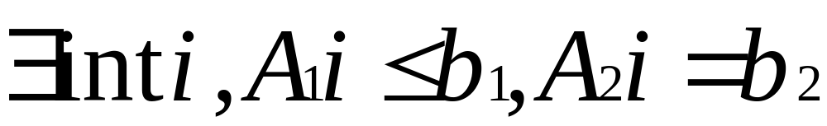
Form of Data Dependence Analysis
Data dependence problems originally contains equalities and equalities
Eliminate inequalities in the problem statement:
  Replace a ≠ b with two sub-problems: a>b or a<b
  We get

Slide 30
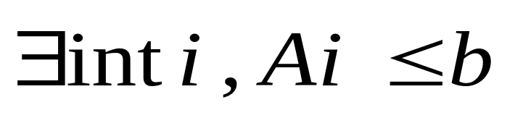
Form of Data Dependence Analysis
Eliminate equalities in the problem statement:
  Replace a =b with two sub-problems: a≤b and b≤a
  We get
Integer programming is NP-complete, i.e. Expensive

Slide 31
Techniques: Inexact Tests
Examples: GCD test, Banerjee’s test
2 outcomes
  No → no dependence
  Don’t know → assume there is a solution → dependence
Extra data dependence constraints
Sacrifice parallelism for compiler efficiency

Slide 32
GCD Test
Is there any dependence?
Solve a linear Diophantine equation
  2*i_{w} = 2*i_{r} + 1
for i = 1, 100
a[2*i] = …
… = a[2*i+1] + 3

Slide 33
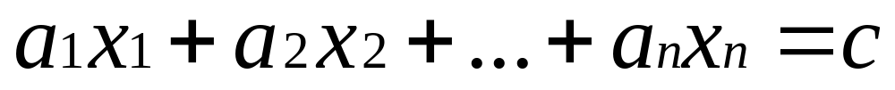
GCD
The greatest common divisor (GCD) of integers a₁, a₂, …, a_{n}, denoted gcd(a₁, a₂, …, a_{n}), is the largest integer that evenly divides all these integers.
Theorem: The linear Diophantine equation
has an integer solution x₁, x₂, …, x_{n} iff gcd(a₁, a₂, …, a_{n}) divides c

Slide 34
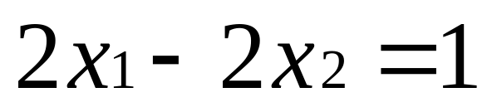
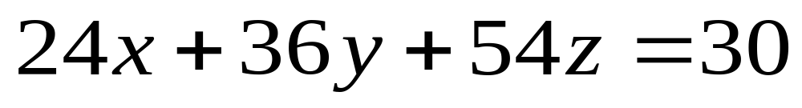
Examples
Example 1: gcd(2,-2) = 2. No solutions
Example 2: gcd(24,36,54) = 6. Many solutions

Slide 35
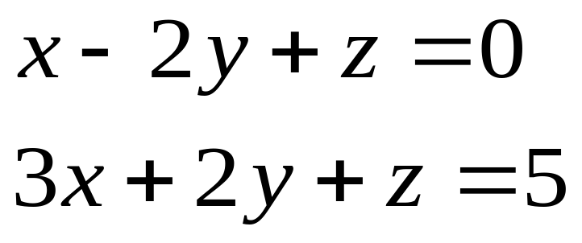
Multiple Equalities
Equation 1: gcd(1,-2,1) = 1. Many solutions
Equation 2: gcd(3,2,1) = 1. Many solutions
Is there any solution satisfying both equations?

Slide 36
The Euclidean Algorithm
Assume a and b are positive integers, and a > b.
Let c be the remainder of a/b.
  If c=0, then gcd(a,b) = b.
  Otherwise, gcd(a,b) = gcd(b,c).
gcd(a₁, a₂, …, a_{n}) = gcd(gcd(a₁, a₂), a₃ …, a_{n})

Slide 37
Exact Analysis
Most memory disambiguations are simple integer programs.
Approach: Solve exactly – yes, or no solution
  Solve exactly with Fourier-Motzkin + branch and bound
  Omega package from University of Maryland

Slide 38
Incremental Analysis
Use a series of simple tests to solve simple programs (based on properties of inequalities rather than array access patterns)
Solve exactly with Fourier-Motzkin + branch and bound
Memoization
  Many identical integer programs solved for each program
  Save the results so it need not be recomputed

Slide 39
State of the Art
Multiprocessors need large outer parallel loops
Many inter-procedural optimizations are needed
  Interprocedural scalar optimizations
    Dependence
    Privatization
    Reduction recognition
  Interprocedural array analysis
    Array section analysis

Slide 40
Summary
DOALL loops
Iteration Space
Data dependence analysis

